Slide 1
Running with Scissors

Slide 2
Running with Scissors
ADVANCED
Notes:
Welcome to Running with Scissors

Slide 3
Expectations
You will leave this workshop with the ability to:
identify the various concerns within a recipe/cookbook
develop InSpec tests for a service/application
create InSpec profiles that provide re-use in cookbook testing
setup the execution of InSpec profiles on every node converge

Slide 4
You are...
interested in learning more about Chef, InSpec, and Habitat.
written a recipe in a cookbook

Slide 5
You are...
interested in learning more about Chef, InSpec, and Habitat.
written a recipe in a cookbook
tested your recipe with Test Kitchen

Slide 6
You are...
interested in learning more about Chef, InSpec, and Habitat.
written a recipe in a cookbook
tested your recipe with Test Kitchen
written a cookbook with a dependency on other cookbooks

Slide 7
You are...
interested in learning more about Chef, InSpec, and Habitat.
written a recipe in a cookbook
tested your recipe with Test Kitchen
written a cookbook with a dependency on other cookbooks

Slide 8
Lord Vader, the DEATH STAR is complete. We scienced the shit out of it!
Presented by ....

Slide 9


Lord Vader, the DEATH STAR is complete. We scienced the shit out of it!
Did anyone write tests? I don't want any vulnerabilities!
Franklin Webber
Training and Technical Content Lead at Chef*
Slack @burtlo
Slack @burtlo
* I am leaving Chef (the company) on June 1, 2018

Slide 11
Expectations
Ask Us Anything: It is important that we answer your questions and set you on the path to be able to find more answers.
Notes:
All throughout this training I strongly encourage you to ask questions whenever you do not understand a topic, an acronym, concept, or software. By asking a question you better your learning and often times better the learning of those with you in this training. Asking questions is a sign of curiosity that we want to encourage and foster while we are here together.

Slide 12
Introduce Yourselves
Name
Where you work
The best part of your work and the most challenging part of your work
A favorite hobby or past time as a child
Why you came to ChefConf and what you want to get out of it
Notes:
Before we start let me introduce myself. Then I would like it if everyone had a chance to introduce themselves.
Instructor Note: Often times with larger, in-person groups I prefer to have the individuals perform this introduction one-on-one. Having people leave their desks and greet as many people as they can during the time allotted. I often feel this works better as it removes the pressure from the single individual to introduce themselves in a way that is presenting themselves and not actually greeting people. When Online, I create a pre-defined order, announce that order, and then invite a person to speak, thank them when they are done.

Slide 13
Schedule
9:00 - 9:50 – Introductions and Code Review
10:00 - 10:50 – First Web Service
11:00 - 11:50 – Second Web Service
12:00 - 13:00 – LUNCH
Notes:
This is the workshop schedule.

Slide 14
Schedule
12:00 - 13:00 – LUNCH
13:00 - 13:50 – Re-use with InSpec Profiles
14:00 - 14:50 – Third Web Service
15:00 - 15:50 – Audit Cookbook
16:00 - 16:30 – A Web Service in Habitat
16:30 - 16:50 – Summary / Wrap up
Notes:
This is the workshop schedule.

Slide 15
Agenda of a Challenge
Overview (5 minutes)
Outline the challenge that you are about to face and define success criteria
Concepts (10 minutes)
Define the tools and techniques you are going to use to solve the problem
Exercise (25 minutes)
During this time you will solve the challenge with all of us supporting one another
Review (10 minutes)
Demonstration and review the techniques and answer questions
Notes:
During the workshop I want to give you as much autonomy as possible to explore the material presented. Learning in this manner can be challenging if you are expecting to be told exactly what code to write to solve the problems. I will start by introducing the challenge and then present the concepts that will assist you in overcoming this challenge. Then it will be your turn to complete the challenge applying these concepts in this specific scenario.
You are not alone. I encourage you to work together to solve these challenges together. Myself and the other facilitators are here to help you if you feel uncertain about what you are suppose to accomplish or how to accomplish it. Together we will get through these exercises.

Slide 16
Remotely
Locally
Login to the a remote workstation:
url:
user:
password:
Requirements:
* Chef DK
* Docker
* kitchen-dokken
Clone/download the following repository:
Notes:
There are two ways to engage with the content. The preferred path for those of us here to support you is on a remote workstation. The link provided has each of your names listed and an instance available that you are able to connect to and use. It has all the tools and the content that was tested against it.

Slide 17
Challenge: Code Review

Slide 18
Challenge: Code Review
Overview
Concepts
Exercise
Review

Slide 19
First Microservice

Slide 20
First Service's Default Recipe
~/cookbooks/ruby_service/recipes/default.rb
directory '/srv'
package 'unzip'
cookbook_file '/srv/specter.zip' do
source 'specter.zip'
notifies :run, 'execute[extract_site]', :immediately
end
execute 'extract_site' do
cwd '/srv'
command 'unzip specter.zip'
not_if { File.exist?('/srv/specter') }
action :nothing
end

Slide 21
First Service's Default Recipe
~/cookbooks/ruby_service/recipes/default.rb
package %w[git-core zlib zlib-devel gcc-c++ patch readline readline-devel libyaml-devel libffi-devel openssl-devel make bzip2 autoconf automake libtool bison curl sqlite-devel]
remote_file '/tmp/ruby-2.5.1.tar.gz' do
source 'https://cache.ruby-lang.org/pub/ruby/2.5/ruby-2.5.1.tar.gz'
end
execute 'extract ruby' do
cwd '/tmp'
command 'tar -xvf ruby-2.5.1.tar.gz'
not_if { File.exist?('/tmp/ruby-2.5.1') }
end

Slide 22
First Service's Default Recipe
~/cookbooks/ruby_service/recipes/default.rb
execute 'configure, make and install ruby' do
cwd '/tmp/ruby-2.5.1'
command './configure && make && make install'
not_if { File.exist?('/usr/local/bin/ruby') }
end
execute 'install bundler' do
command '/usr/local/bin/gem install bundler'
not_if { File.exist?('/srv/specter/Gemfile.lock') }
end
execute 'bundle install' do
cwd '/srv/specter'
command '/usr/local/bin/bundle install'
not_if { File.exist?('/usr/local/bin/bundle') }
end

Slide 23
First Service's Default Recipe
~/cookbooks/ruby_service/recipes/default.rb
template '/etc/systemd/system/specter.service' do
source 'service.erb'
variables({ service_name: 'specter', working_directory: '/srv/specter' })
end
template '/srv/specter/start.sh' do
source 'start.sh.erb'
mode '0774'
end
template '/srv/specter/stop.sh' do
source 'stop.sh.erb'
mode '0774'
end
service 'specter' do
action :start
end

Slide 24
Objective
Read through the source code and identify:
What is this recipe doing?
Is there a lot of repetition in this recipe?
How re-usable is this recipe?
What and how would you test this recipe?

Slide 25
Challenge: Code Review
Overview
Concepts
Exercise
Review

Slide 26
Separation of Concerns

Slide 27
Single Responsibility Principle
A recipe should have only one reason to change.

Slide 28
Interface Segregation Principle
Other recipes should not be forced to depend on resources that they do not use.

Slide 29
Challenge: Code Review
Overview
Concepts
Exercise
Review

Slide 30
Enter the Project Directory
> cd first_service

Slide 31
Converge a Test System
> kitchen converge
-----> Starting Kitchen (v1.20.0)
-----> Creating <default-centos-7>...
Creating kitchen sandbox at /Users/franklinwebber/.dok...ault-centos-7
Creating verifier sandbox at /Users/franklinwebber/.do...ault-centos-7
Building work image..
Creating container 06915d9eff-default-centos-7
Finished creating <default-centos-7> (0m42.81s).
-----> Converging <default-centos-7>...
Creating kitchen sandbox in /Users/franklinwebber/.dok... ult-centos-7
Preparing dna.json

Slide 32
Code Review
Identify what the recipe accomplishes
Identify the different concerns within the recipe
Evaluate the usability, maintainability, and portability
Express why you would change the recipe and how you would go about making that change.

Slide 33
Challenge: Code Review
Overview
Concepts
Exercise
Review

Slide 34
The Purpose of the Recipe

Slide 35
Different Concerns

Slide 36
Usability, Maintainability, Portability

Slide 37
Challenge: Code Review
Overview
Concepts
Exercise
Review

Slide 38
Extra Time
Help Others: The best way to learn is to teach. This will help reinforce what it is you accomplished.
Break It: If everything works the first time go back and make some changes. Explore! Discovering the boundaries will help you when you continue on your journey.
Take a Diversion: Several exercises here are open to many different paths. For clarity I will keep the exercises pretty bounded, if something catches your eye that is off the path -- take it.
Notes:
This curiosity can also be employed by exploring the boundaries of the tools you are using and the language you are writing. The exercises and the labs we will perform will often lead you through examples that work from the beginning to the end. When you develop solutions it is rare that something works from the start all the way to the end. Errors and issues come up from typos or the incorrect usage of a command of the programming language. When you fall off the path it can often be hard to find your way back. Here, if you find yourself always on the correct path explore what happens when you step off of it, what you see, the error messages you are presented with, the new results you might find.

Slide 39
Discussion
What questions can we answer for you?

Slide 40
Break

Slide 41
Challenge: First Web Service
Overview
Concepts
Exercise
Review

Slide 42
Web Service
The web service launches a website that accepts JSON payloads.
GET http://localhost:8000/scans
POST http://localhost:8000/scans with JSON payload
GET http://localhost:8000/scans/ID
DELETE http://localhost:8000/scans/ID

Slide 43
Ruby Implementation
Ruby 2.5.1
Bundler
Rackup
systemd service

Slide 44
Challenge: First Web Service
Overview
Concepts
Exercise
Review

Slide 45
Where do you write your tests
What tests do you write
How do we execute tests
Refactor

Slide 46
Kitchen Configuration
When chef generates a cookbook a default .kitchen.yml is created or it can be created with the command kitchen init.
http://kitchen.ci/docs/getting-started/kitchen-yml
The configuration is stored in a file format called YAML.
http://yaml.org

Slide 47
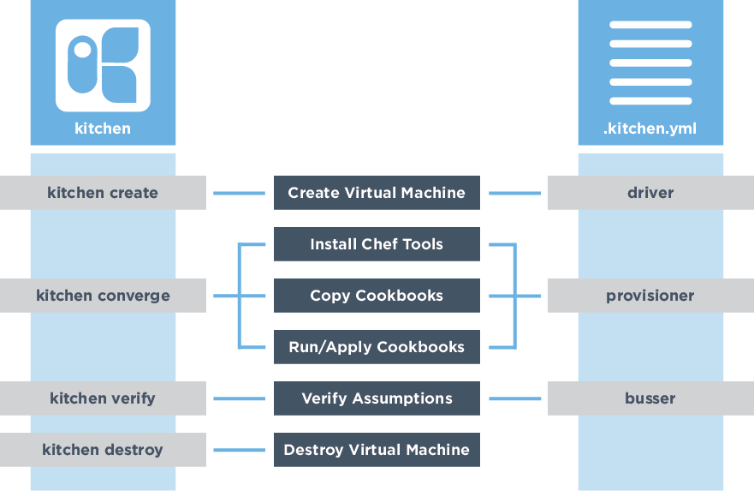
Test Kitchen's Configuration
Create Test Instance
Install Chef
Synchronize Cookbooks
Apply the Run List
Execute Tests

Slide 48
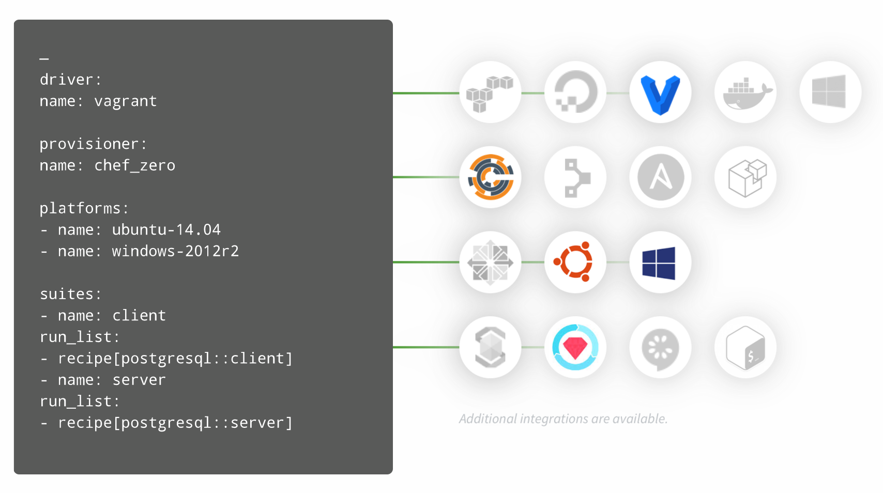

Test Kitchen's Configuration Makes it Versatile
kitchen.ci

Slide 49
Kitchen Dokken and InSpec
~/cookbooks/ruby_service/.kitchen.yml
driver:
name: dokken
provisioner:
name: dokken
transport:
name: dokken
verifier:
name: inspec

Slide 50
Kitchen Platforms and Test Suites
~/cookbooks/ruby_service/.kitchen.yml
platforms:
- name: centos-7
driver:
image: dokken/centos-7
privileged: true
pid_one_command: /usr/lib/systemd/systemd
volumes:
- /sys/fs/cgroup:/sys/fs/cgroup:ro # required by systemd
suites:
- name: default
run_list:
- recipe[specter_cookbook::default]
verifier:
inspec_tests:
- test/integration/default
attributes:

Slide 51
View the Test Matrix for Test Kitchen
> kitchen list
Instance Driver Provisioner Verifier Transport Last Action Last Error
default-centos-7 Dokken Dokken Inspec Dokken Converged <None>

Slide 52
Kitchen Platforms and Test Suites
~/cookbooks/ruby_service/.kitchen.yml
platforms:
- name: centos-7
driver:
image: dokken/centos-7
privileged: true
pid_one_command: /usr/lib/systemd/systemd
volumes:
- /sys/fs/cgroup:/sys/fs/cgroup:ro # required by systemd
suites:
- name: default
run_list:
- recipe[specter_cookbook::default]
verifier:
inspec_tests:
- test/integration/default
attributes:

Slide 53
Default Suite Test Files
~/cookbooks/ruby_service/test/integration/default/default_test.rb
# encoding: utf-8
# Inspec test for recipe ruby_service::default
# The Inspec reference, with examples and extensive documentation, can be
# found at http://inspec.io/docs/reference/resources/

Slide 54
Where do you write your tests
What tests do you write
How do we execute tests
Refactor

Slide 55
InSpec: command
Use the command InSpec audit resource to test an arbitrary command that is run on the system.
describe command('/usr/local/bin/ruby') do
it { should exist }
end
describe command('/usr/local/bin/ruby -v') do
its('stdout') { should match('2.5.1') }
end

Slide 56
InSpec: command
Use the command InSpec audit resource to test an arbitrary command that is run on the system.
describe command('curl http://localhost:8000') do
its('stdout') { should match('welcome friend') }
end

Slide 57
InSpec: host
Use the host InSpec audit resource to test the name used to refer to a specific host and its availability, including the Internet protocols and ports over which that host name should be available.
describe host('localhost', port: 8000, protocol: 'tcp') do
it { should be_reachable }
it { should be_resolvable }
end

Slide 58
InSpec: port
Use the port InSpec audit resource to test basic port properties, such as port, process, if it’s listening.
describe port(8000) do
it { should be_listening }
its('processes') {should include 'ruby'}
end

Slide 59
InSpec: http
Use the http InSpec audit resource to test an http endpoint.
describe http('http://localhost:8000', enable_remote_worker: true) do
its('status') { should eq 200 }
end

Slide 60
InSpec: service
Use the service InSpec audit resource to test if the named service is installed, running and/or enabled.
describe service('ruby_service') do
it { should be_installed }
it { should be_running }
end

Slide 61
Where do you write your tests
What tests do you write
How do we execute tests
Refactor

Slide 62
Execute the Tests
> kitchen verify
-----> Starting Kitchen (v1.20.0)
-----> Verifying <default-centos-7>...
Loaded tests from {:path=>".Users.franklinwebber.running_with_scissors.specter_cookbook.test.integration.default"}
Profile: tests from {:path=>"/Users/franklinwebber/running_with_scissors/specter_cookbook/test/integration/default"} (tests from {:path=>".Users.franklinwebber.running_with_scissors.specter_cookbook.test.integration.default"})
Version: (not specified)

Slide 63
Where do you write your tests
What tests do you write
How do we execute tests
Refactor

Slide 64
Chef: variables
A variable whose name begins with a lowercase letter (a-z) or underscore (_) is a local variable or method invocation.

Slide 65
Chef: attributes
An attribute is a specific detail about a node. Attributes are used by the chef-client to understand:
The current state of the node
What the state of the node was at the end of the previous chef-client run
What the state of the node should be at the end of the current chef-client run
https://docs.chef.io/attributes.html

Slide 66
Chef: include_recipe
https://docs.chef.io/dsl_recipe.html#include-recipes

Slide 67
Chef: include_recipe
~/cookbooks/ruby_service
> chef generate recipe ruby
https://docs.chef.io/dsl_recipe.html#include-recipes

Slide 68
Chef: include_recipe
~/cookbooks/ruby_service/recipes/default.rb
# ... other resources ...
include_recipe 'ruby'
# ... other resources ...
https://docs.chef.io/dsl_recipe.html#include-recipes

Slide 69
Chef: include_recipe
~/cookbooks/ruby_service/recipes/ruby.rb
# ... other resources ...
include_recipe 'ruby'
# ... other resources ...
https://docs.chef.io/dsl_recipe.html#include-recipes

Slide 70
Chef: Custom Resource
A custom resource is an extension of Chef that adds your own resources and is implemented and shipped as part of a cookbook.
~/cookbooks/ruby_service/recipes/default.rb
ruby_service_site 'specter' do
source 'specter.zip'
path '/srv'
end

Slide 71
Chef: Custom Resource
A custom resource is an extension of Chef that adds your own resources and is implemented and shipped as part of a cookbook.
~/cookbooks/ruby_service
> chef generate resource site

Slide 72
Chef: Custom Resource
A custom resource is an extension of Chef that adds your own resources and is implemented and shipped as part of a cookbook.
~/cookbooks/ruby_service/resources/site.rb
property :site_name, String, name_property: true
property :source, String, required: true
property :path, String, required: true
action :create do
# ...
end

Slide 73
Chef: Custom Resource
A custom resource is an extension of Chef that adds your own resources and is implemented and shipped as part of a cookbook.
~/cookbooks/ruby_service/resources/site.rb
action :create do
directory '/srv' do # ...
package 'unzip' # ...
cookbook_file '/srv/specter.zip' do # ...
execute 'extract_site' do # ...
end

Slide 74
Where do you write your tests
What tests do you write
How do we execute tests
Refactor

Slide 75
Challenge: First Web Service
Overview
Concepts
Exercise
Review

Slide 76
First Web Service
Converge the cookbook
Write tests for the cookbook
Execute the tests
Assist, Break it, Explore or Refactor
Write at least one test that give you the confidence that the site is working.

Slide 77
Challenge: First Web Service
Overview
Concepts
Exercise
Review

Slide 78
Live Demonstration

Slide 79
Challenge: First Web Service
Overview
Concepts
Exercise
Review

Slide 80
Break

Slide 81
Challenge: Second Web Service
Overview
Concepts
Exercise
Review

Slide 82
Web Service
The web service launches a website that accepts JSON payloads.
GET http://localhost:8000/scans
POST http://localhost:8000/scans with JSON payload
GET http://localhost:8000/scans/ID
DELETE http://localhost:8000/scans/ID

Slide 83
JavaScript/Node Implementation
Node 9.5.0
npm
node

Slide 84
Challenge: Second Web Service
Overview
Concepts
Exercise
Review

Slide 86
Challenge: Second Web Service
Overview
Concepts
Exercise
Review

Slide 87
Second Web Service
Converge the cookbook
Write tests for the cookbook
Execute the tests
Assist, Break it, Explore or Refactor
Write at least one test that give you the confidence that the site is working.

Slide 88
Challenge: Second Web Service
Overview
Concepts
Exercise
Review

Slide 89
Live Demonstration

Slide 90
Challenge: Second Web Service
Overview
Concepts
Exercise
Review

Slide 91
Break

Slide 92
Challenge: Re-use with InSpec Profiles
Overview
Concepts
Exercise
Review

Slide 93
Test Duplication
Both of these web services share a common interface even if the implementation differs. If a third implementation of the site were to appear you would find yourself repeating yourself again.

Slide 94
Challenge: Re-use with InSpec Profiles
Overview
Concepts
Exercise
Review

Slide 95
Initializing an InSpec profile
Using a InSpec profile within Test Kitchen
Conditionally executing controls

Slide 96
Challenge: Re-use with InSpec Profiles
Overview
Concepts
Exercise
Review

Slide 97
Re-use with InSpec Profiles
Initialize an InSpec profile
Populate the InSpec profile with your controls
Set framework specific controls as conditional
Both web service cookbooks are verified by an InSpec profile

Slide 98
Challenge: Re-use with InSpec Profiles
Overview
Concepts
Exercise
Review

Slide 100
Challenge: Re-use with InSpec Profiles
Overview
Concepts
Exercise
Review

Slide 101
Break

Slide 102
Challenge: Third Web Service
Overview
Concepts
Exercise
Review

Slide 103
Web Service
The web service launches a website that accepts JSON payloads.
GET http://localhost:8000/scans
POST http://localhost:8000/scans with JSON payload
GET http://localhost:8000/scans/ID
DELETE http://localhost:8000/scans/ID

Slide 104
Rust Application
rust
rustup (nightly releases)
cargo
diesel-cli

Slide 105
Challenge: Third Web Service
Overview
Concepts
Exercise
Review

Slide 106
Initializing an InSpec profile
Using a InSpec profile within Test Kitchen
Conditionally executing controls

Slide 107
Challenge: Third Web Service
Overview
Concepts
Exercise
Review

Slide 108
Third Web Service
Converge the cookbook
Write tests in the cookbook or in the profile
Execute the tests
Assist, Break it, Explore or Refactor
Write at least one test that give you the confidence that the site is working.

Slide 109
Challenge: Third Web Service
Overview
Concepts
Exercise
Review

Slide 110
Live Demonstration

Slide 111
Challenge: Third Web Service
Overview
Concepts
Exercise
Review

Slide 112
Break

Slide 113
Challenge: Audit Cookbook
Overview
Concepts
Exercise
Review

Slide 114
Scanning on Converge
Ensure that your tests work during development and in production.

Slide 115
Challenge: Audit Cookbook
Overview
Concepts
Exercise
Review

Slide 116
audit cookbook (and its attributes)
wrapper cookbook pattern
Chef.event_handler (12.5)
chef_handler (external cookbook or chef-client 14.0)
testing it with test kitchen

Slide 117
# @see https://github.com/chef-cookbooks/audit
node.default['audit'] = { 'reporter' => 'json-file', 'interval' => { 'enabled' => false }, 'profiles' => [ # TODO: A profile that looks the one that they developed but on the web # TODO: their profile zipped up and stored into the cookbook { "name" => "linux-baseline", "supermarket" => "dev-sec/linux-baseline" } ]}

Slide 118
Using Chef.event_handler - bash
# @see https://docs.chef.io/dsl_handler.htmlChef.event_handler do on :run_completed do # BASH Solution scan_path = "#{Chef::Config[:cookbook_path]}/audit/inspec-*.json" puts `curl -d @$(find . -name #{scan_path}) -H "Content-Type: application/json" http://localhost:8000/scans` # ShellOut Solution upload = Mixlib::ShellOut.new "curl -d @$(find . -name #{scan_path}) -H 'Content-Type: application/json' http://localhost:8000/scans" upload.run_command # Ruby/Chef Solution connection = Chef::HTTP.new('http://localhost:8000') headers = { 'Content-Type' => 'application/json' } Dir["#{Chef::Config[:cookbook_path]}/audit/inspec-*.json"].each do |scan_file| data = File.read(scan_file) connection.post("/scans", data.to_s, headers) end endend

Slide 119
Using Chef.event_handler - shell_out
# @see https://docs.chef.io/dsl_handler.htmlChef.event_handler do on :run_completed do # BASH Solution scan_path = "#{Chef::Config[:cookbook_path]}/audit/inspec-*.json" puts `curl -d @$(find . -name #{scan_path}) -H "Content-Type: application/json" http://localhost:8000/scans` # ShellOut Solution upload = Mixlib::ShellOut.new "curl -d @$(find . -name #{scan_path}) -H 'Content-Type: application/json' http://localhost:8000/scans" upload.run_command # Ruby/Chef Solution connection = Chef::HTTP.new('http://localhost:8000') headers = { 'Content-Type' => 'application/json' } Dir["#{Chef::Config[:cookbook_path]}/audit/inspec-*.json"].each do |scan_file| data = File.read(scan_file) connection.post("/scans", data.to_s, headers) end endend

Slide 120
Using Chef.event_handler - ruby/chef
# @see https://docs.chef.io/dsl_handler.htmlChef.event_handler do on :run_completed do # BASH Solution scan_path = "#{Chef::Config[:cookbook_path]}/audit/inspec-*.json" puts `curl -d @$(find . -name #{scan_path}) -H "Content-Type: application/json" http://localhost:8000/scans` # ShellOut Solution upload = Mixlib::ShellOut.new "curl -d @$(find . -name #{scan_path}) -H 'Content-Type: application/json' http://localhost:8000/scans" upload.run_command # Ruby/Chef Solution connection = Chef::HTTP.new('http://localhost:8000') headers = { 'Content-Type' => 'application/json' } Dir["#{Chef::Config[:cookbook_path]}/audit/inspec-*.json"].each do |scan_file| data = File.read(scan_file) connection.post("/scans", data.to_s, headers) end endend

Slide 121
Adding a dependency on chef_handler
metadata.rb
name 'azrael'maintainer 'The Authors'maintainer_email 'you@example.com'license 'All Rights Reserved'description 'Installs/Configures azrael'long_description 'Installs/Configures azrael'version '0.1.0'chef_version '>= 12.14' if respond_to?(:chef_version)depends 'audit'depends 'chef_handler'

Slide 122
Using the chef_handler resource
# @see https://docs.chef.io/resource_chef_handler.htmlinclude_recipe 'audit'chef_handler 'Azrael::Handler::UploadFile' do source "#{Chef::Config[:cookbook_path]}/#{cookbook_name}/files/default/upload_handler.rb" arguments [ server: 'http://localhost:8000' ] supports report: true, exception: true action :enableend

Slide 123
Adding to the cookbook Berksfile
Berksfile
# frozen_string_literal: truesource 'https://supermarket.chef.io'metadatacookbook 'azrael', path: '../azrael'

Slide 124
Adding a new test suite
.kitchen.yml
suites: - name: default run_list: - recipe[node_service::default] verifier: inspec_tests: - ../../web_service attributes: - name: scan run_list: - recipe[node_service::default] - recipe[azrael::default] verifier: inspec_tests: - test/integration/default attributes:

Slide 125
Test the upload / results
cookbooks/COOKBOOK/test/integration/scan/default_test.rb
# encoding: utf-8# REFERENCE# https://inspec.io/docs/reference/resources/command# https://inspec.io/docs/reference/resources/host# https://inspec.io/docs/reference/resources/port# https://inspec.io/docs/reference/resources/service# https://inspec.io/docs/reference/resources/file/describe file('/upload-response.txt') do it { should exist } its('content') { should_not match /FAILED TO CONTACT http:\/\/localhost:8000/ }end# https://inspec.io/docs/reference/resources/http/describe json(command: 'curl http://localhost:8000/scans') do its('count') { should > 1 } its(['last']) { should cmp '1.42.3' } its(['last','data']) { should cmp '1.42.3' } its(['last','data','version']) { should cmp '1.42.3' }end

Slide 126
Challenge: Audit Cookbook
Overview
Concepts
Exercise
Review

Slide 127
Audit Cookbook
Add a dependency on the cookbook
Add a new test suite that installs the service and scans
Define the attributes within the wrapper recipe
Use Chef.event_handler or chef_handler
Test that the scan completed and uploaded
The scan completes successfully and is verified by a test

Slide 128
Challenge: Audit Cookbook
Overview
Concepts
Exercise
Review

Slide 129
Live Demonstration

Slide 130
Challenge: Audit Cookbook
Overview
Concepts
Exercise
Review

Slide 131
Break

Slide 132
Challenge: A Web Service in Habitat
Overview
Concepts
Exercise
Review

Slide 133
Patterns
In all of the web services we identified a pattern:
* Install the framework
* Copy the source
* Install dependencies
* Migrate the database
* Create / Start a service

Slide 134
Challenge: A Web Service in Habitat
Overview
Concepts
Exercise
Review

Slide 135
Generate a habitat plan
Habitat scaffolding
Habitat Studio
Build, Run, Export
InSpec Profiles testing Habitat

Slide 136
Challenge: A Web Service in Habitat
Overview
Concepts
Exercise
Review

Slide 137
A Web Service in Habitat
Generate a habitat plan and modify it as necessary
Enter the Habitat studio, build, run and export
Generate a Habitat artifact for the Service
Run the service artifact and the profile artifact
The Habitat supervisor is running the service artifact and profile artifact.

Slide 138
Challenge: A Web Service in Habitat
Overview
Concepts
Exercise
Review

Slide 139
Live Demonstration

Slide 140
Challenge: A Web Service in Habitat
Overview
Concepts
Exercise
Review

Slide 141
Break

Slide 142
Summary / Wrap-Up

Slide 143
Resources - Chef

Slide 144
Resources - InSpec

Slide 145
Resources - Habitat

Slide 146
Conference Schedule

Slide 147
Schedule Suggestion

Slide 148
Learn Chef Rally Booth

